Slide 1
SOEN 341 wk 12
Introduction to CMMI
Software Engineering Institute
CMU/SEI-2010-TR-033

Slide 2
History
In the 1930s, Walter Shewhart began work in process improvement with his principles of statistical quality control [Shewhart 1931].
These principles were refined by W. Edwards Deming [Deming 1986], Phillip Crosby [Crosby 1979], and Joseph Juran [Juran 1988].
Watts Humphrey, Ron Radice, and others extended these principles further and began applying them to software in their work at IBM (International Business Machines) and the SEI [Humphrey 1989].
Humphrey’s book, Managing the Software Process, provides a description of the basic principles and concepts on which many of the Capability Maturity Models® (CMMs®) are based

Slide 3
Purpose
Like other CMMs, CMMI models provide guidance to use when developing processes. CMMI models are not processes or process descriptions
The SEI created the first CMM designed for software organizations and published it in a book, The Capability Maturity Model: Guidelines for Improving the Software Process [SEI 1995].
Today, CMMI is an application of the principles introduced almost a century ago to this never-ending cycle of process improvement.
In particular, the process areas of a CMMI model typically do not map one to one with the processes used in your organization.

Slide 4
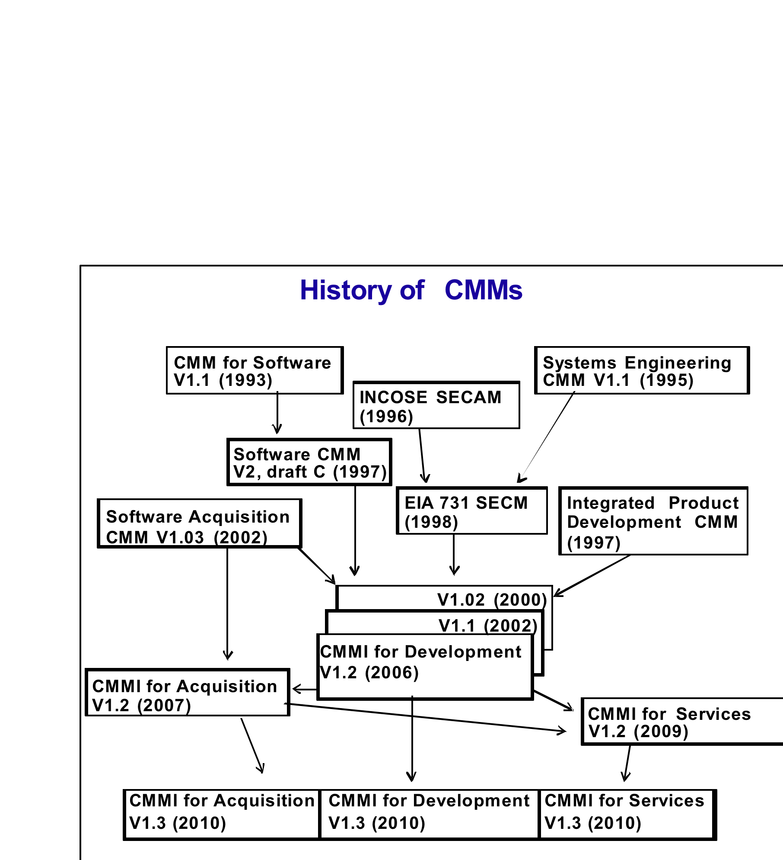

Slide 5
Institutionalization
Institutionalization is an important concept in process improvement.
Institutionalization:
The process is ingrained in the way the work is performed
There is commitment and consistency to performing the process.
An institutionalized process is more likely to be retained during times of stress.
When the requirements and objectives for the process change, the implementation of the process may also need to change to ensure that it remains effective.
The generic practices describe activities that address these aspects of institutionalization.

Slide 6
Degree
The degree of institutionalization is embodied in the generic goals and expressed in the names of the processes associated with each goal as indicated below.
Generic Goals and Process Names
Generic Goal Progression of Processes
GG 1 Performed process
GG 2 Managed process
GG 3 Defined process

Slide 7
Performed Process
A performed process
A process that accomplishes the work necessary to satisfy the specific goals of a process area

Slide 8
Managed process
A managed process is a performed process that is planned and executed in accordance with policy
It employs skilled people having adequate resources to produce controlled outputs
It involves relevant stakeholders.
It is monitored, controlled, and reviewed; and is evaluated for adherence to its process description.

Slide 9
Distinction between levels
A critical distinction between a performed process and a managed process is the extent to which the process is managed.
A managed process is planned (the plan can be part of a more encompassing plan) and the execution of the process is managed against the plan.
Corrective actions are taken when the actual results and execution deviate significantly from the plan.
A managed process achieves the objectives of the plan and is institutionalized for consistent execution.

Slide 10
Defined process
A defined process is a managed process that is tailored from the organization’s set of standard processes according to the organization’s tailoring guidelines
It has a maintained process description; and contributes process related experiences to the organizational process assets.

Slide 11
Maturity Levels
The levels describe the maturity of organizational control of the development processes of a corporation
How well a company sets up and manages the process of product development
It defines the quality of management of a software process for the development of systems
5 levels are defined

Slide 12
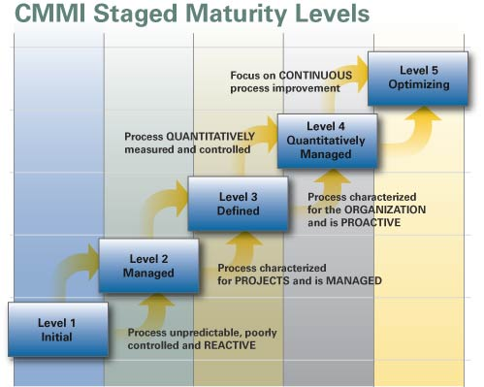

Slide 13
CMMs focus on improving processes in an organization.
They contain the essential elements of effective processes for one or more disciplines
They describe an evolutionary improvement path from ad hoc, immature processes to disciplined, mature processes with improved quality and effectiveness.
The SEI created the first CMM designed for software organizations and published it in a book, The Capability Maturity Model: Guidelines for Improving the Software Process [SEI 1995].

Slide 14
Goals
A specific goal describes the unique characteristics that must be present to satisfy the process area
Generic goals are called “generic” because the same goal statement applies to multiple process areas. A generic goal describes the characteristics that must be present to institutionalize processes that implement a process area.

Slide 15
Specific and Generic Practices
A specific practice is the description of an activity that is considered important in achieving the associated specific goal.
A subpractice is a detailed description that provides guidance for interpreting and implementing a specific or generic practice
A Generic practices are called “generic” because the same practice applies to multiple process areas. The generic practices are associated with a generic goal
A informative note is text that can accompany nearly any other model component. It may provide detail, background, or rationale. A note is an informative model component.

Slide 16
Sample Pages
The following are sample pages from process areas
They show the different process area components, labeled so that you can identify them.
Notice that components differ typographically so that you can easily identify each one.

Slide 17
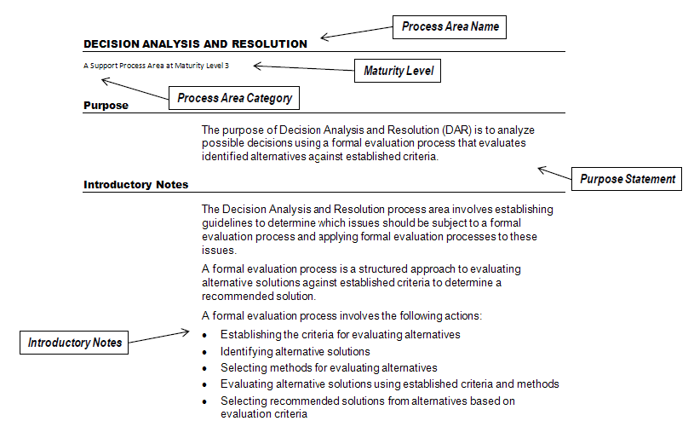
Sample Page 1

Slide 18
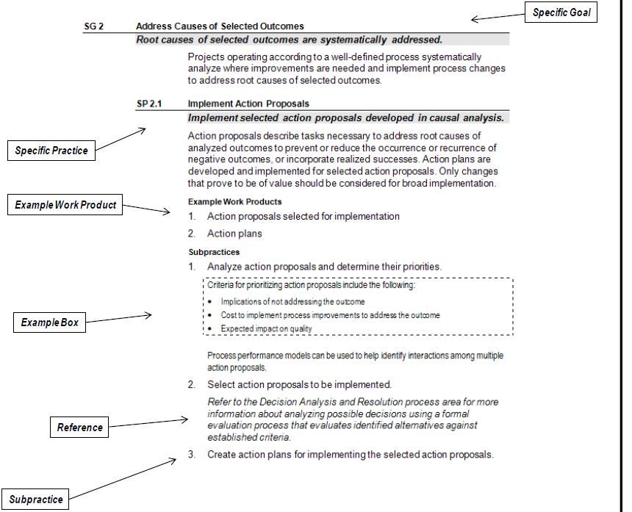

Slide 19
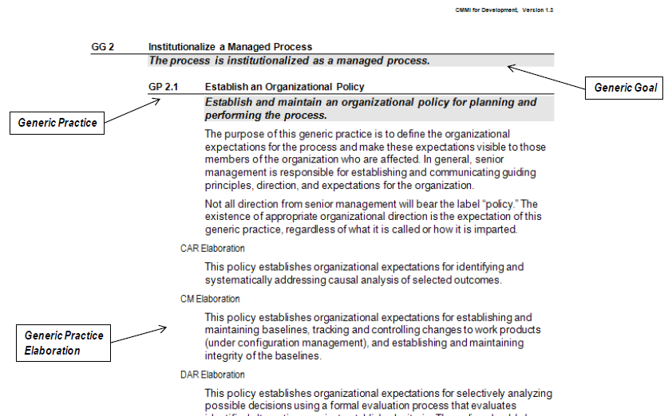

Slide 20
Improvement Paths
These two improvement paths are associated with the two types of levels:
capability levels and maturity levels.
The two paths are called “continuous” and “staged.”
Using the continuous path enables you to achieve “capability levels.”
Using the staged path enables you to achieve “maturity levels.”

Slide 21
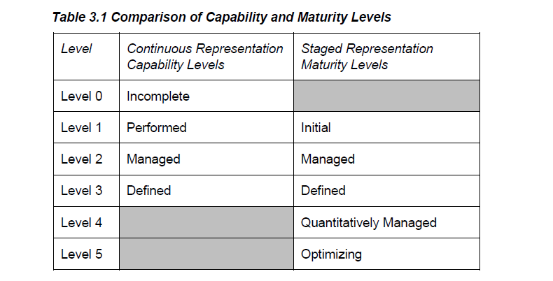
Capability and Maturity

Slide 22
Capability and Maturity
Capability levels apply to an organization’s process improvement achievement in individual process areas.
These levels are a means for incrementally improving the processes corresponding to a given process area. The four capability levels are numbered 0 through 3.
Maturity levels apply to an organization’s process improvement achievement across multiple process areas.
These levels are a means of improving the processes corresponding to a given set of process areas (i.e., maturity level). The five maturity levels are numbered 1 through 5.

Slide 23
Capability levels
The capability levels of a process area are achieved through the application of generic practices or suitable alternatives to the processes associated with that process area.
Reaching capability level 1 for a process area is equivalent to saying that the processes associated with that process area are performed processes.
Reaching capability level 2 for a process area is equivalent to saying that there is a policy that indicates you will perform the process. A capability level 2 process can be planned and monitored just like any project or support activity.
Reaching capability level 3 for a process area is equivalent to saying that an organizational standard process exists associated with that process area, which can be tailored to the needs of the project.

Slide 24
Maturity Levels
A maturity level consists of related specific and generic practices for a predefined set of process areas that improve the organization’s overall performance.
A maturity level is a defined evolutionary plateau for organizational process improvement. Each maturity level matures an important subset of the organization’s processes

Slide 25
Maturity Levels
A maturity level consists of related specific and generic practices for a predefined set of process areas that improve the organization’s overall performance.
A maturity level is a defined evolutionary plateau for organizational process improvement. Each maturity level matures an important subset of the organization’s processes

Slide 26
Maturity levels
At maturity level 1, processes are usually ad hoc and chaotic.
At maturity level 2, the projects have ensured that processes are planned and executed in accordance with policy
At maturity level 3, processes are well characterized and understood, and are described in standards, procedures, tools, and methods.
At maturity level 4, the organization and projects establish quantitative objectives for quality and process performance and use them as criteria in managing projects.
At maturity level 5, an organization continually improves its processes based on a quantitative understanding of its business objectives and performance needs.

Slide 27
Interpreting CMMI When Using Agile Approaches
CMMI practices are designed to provide value across a range of different situations and thus are stated in general terms.
To help those who use Agile methods to interpret CMMI practices in their environments, notes have been added to selected process areas.
All of the notes begin with the words, “In Agile environments” and are in example boxes to help you to easily recognize them and remind you that these notes are examples of how to interpret practices

Slide 28
Agile Approaches
Multiple Agile approaches exist.
The phrases “Agile environment” and “Agile method” are shorthand for any Such approaches are characterized by the following:
Direct involvement of the customer in product development Use of multiple development iterations to learn about and evolve the product
Customer willingness to share in the responsibility for decisions and risk
Many development and management approaches can share one or more of these characteristics and yet not be called “Agile.”
For example, some teams are arguably “Agile” even though the term Agile is not used. Even if you are not using an Agile approach, you might still find value in these notes.

